Slide 1
Role of Operations and Supply Chain Management in the Uncertain World
Vipin B, IIT Kanpur

Slide 2
India’s PPE status: from shortage to excess

Slide 3


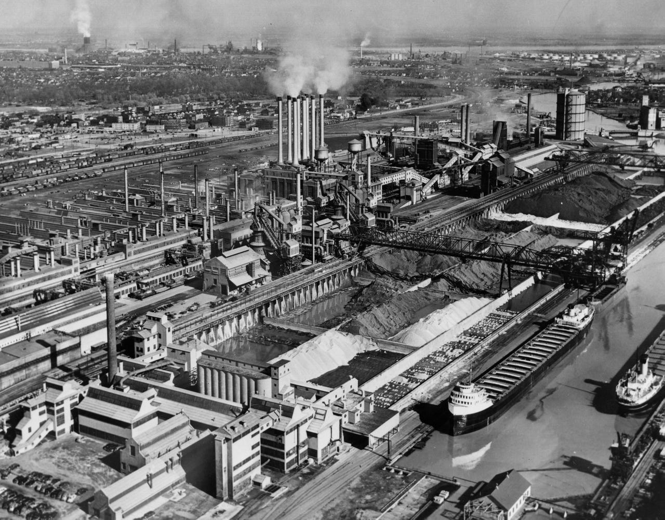
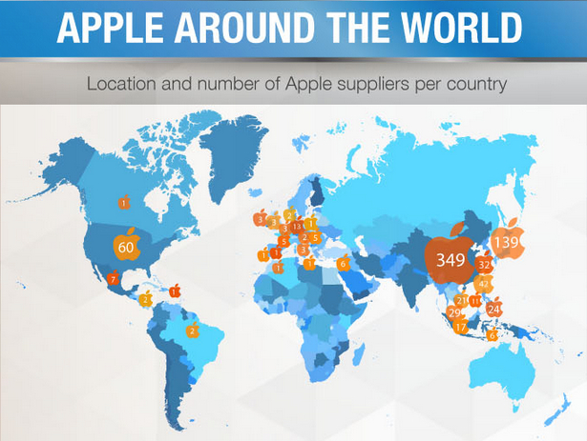
Decentralized supply chain
Centralized vs decentralized supply chains
Vertically integrated supply chain
River rouge plant
Raw
materials
Cars
Source: detroitnews.com
Source: econlife.com

Slide 4
Impact of globalization on supply chain

Slide 5
Tsunami-Japan 2011: Impact on Intel
Failure of Intel’s facility
Loss of key suppliers
Power failure resulting in no production at the suppliers’ facilities
Quality problems
Transportation issue
Digital connectivity issue

Slide 6
Tsunami: Intel’s response
Searching for alternate suppliers
Redesigning the production process to incorporate the newly added suppliers
Working with competitors for finding suppliers (co-opetition)
Identifying the inventory available at any stage in the supply chain
Working with government to ensure uninterrupted power supply

Slide 7
Challenges in globalization: Risk of poor visibility

Slide 8
What was the problem with Mattel?
Mattel
LeeDer (tier 1)
Dongxing (tier 2)
Lack of visibility into the entire supply chain
Lack of information sharing
False certification of quality by tier 2 supplier

Slide 9
What was the problem for Aston Martin?
Accelerator pedal failure (break)
Poor quality plastic used by tier 1 supplier for producing the brake
Lack of quality standards at tier 2 supplier who provided the plastics
Aston Martin
Shenzhen Kexiang Mould Tool Co Ltd (tier 1)
Synthetic Plastic Raw Material Co Ltd (tier 2)

Slide 10
COVID19: mother of all disruptions; a black swan
An Unknown event, resulted in both supply and demand disruptions
Demand
High ---Mask, sanitizers, grocery items, medicines, gloves, agricultural items, etc.
Low ---fashion products, motor vehicles etc.
Supply
Low for most of the products due to
production stoppage
limited raw materials, sub-assemblies, and transportation facilities
High for medical equipment and essential items (due to hoarding)

Slide 11
How organizations reacted?

Slide 12
How organizations reacted?

Slide 13
Changing the way of doing business

Slide 14
Changing the way of doing business

Slide 15
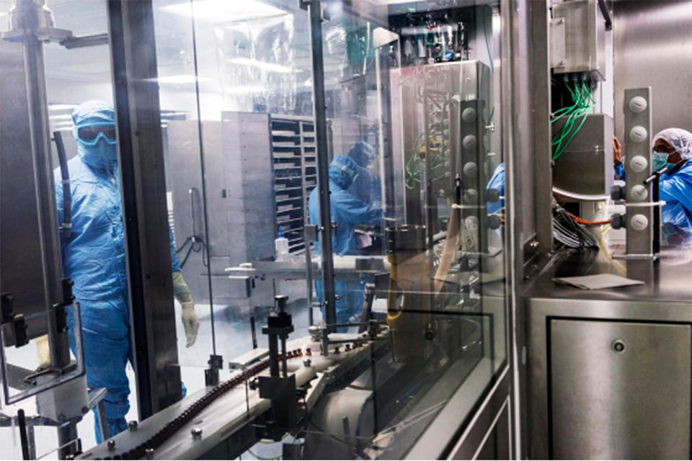
Case of Serum Institute for COVID 19: Multi-pronged Approach
Use of existing three facilities by foregoing the sure shot lucrative revenue
New dedicated facility
Research and development of four different vaccines
Priority for India
Starting the production before the approval
Source: https://www.forbes.com/sites/naazneenkarmali/2020/10/07/serum-institute-of-india-takes-a-multipronged-approach-in-attempt-to-produce-worlds-first-covid-19-vaccines/?sh=304bc3e114ca

